Slide 1
of 20

Slide 2
of 20

Slide 3
of 20

Slide 4

of 20

Slide 5

of 20

Slide 6

of 20

Slide 7
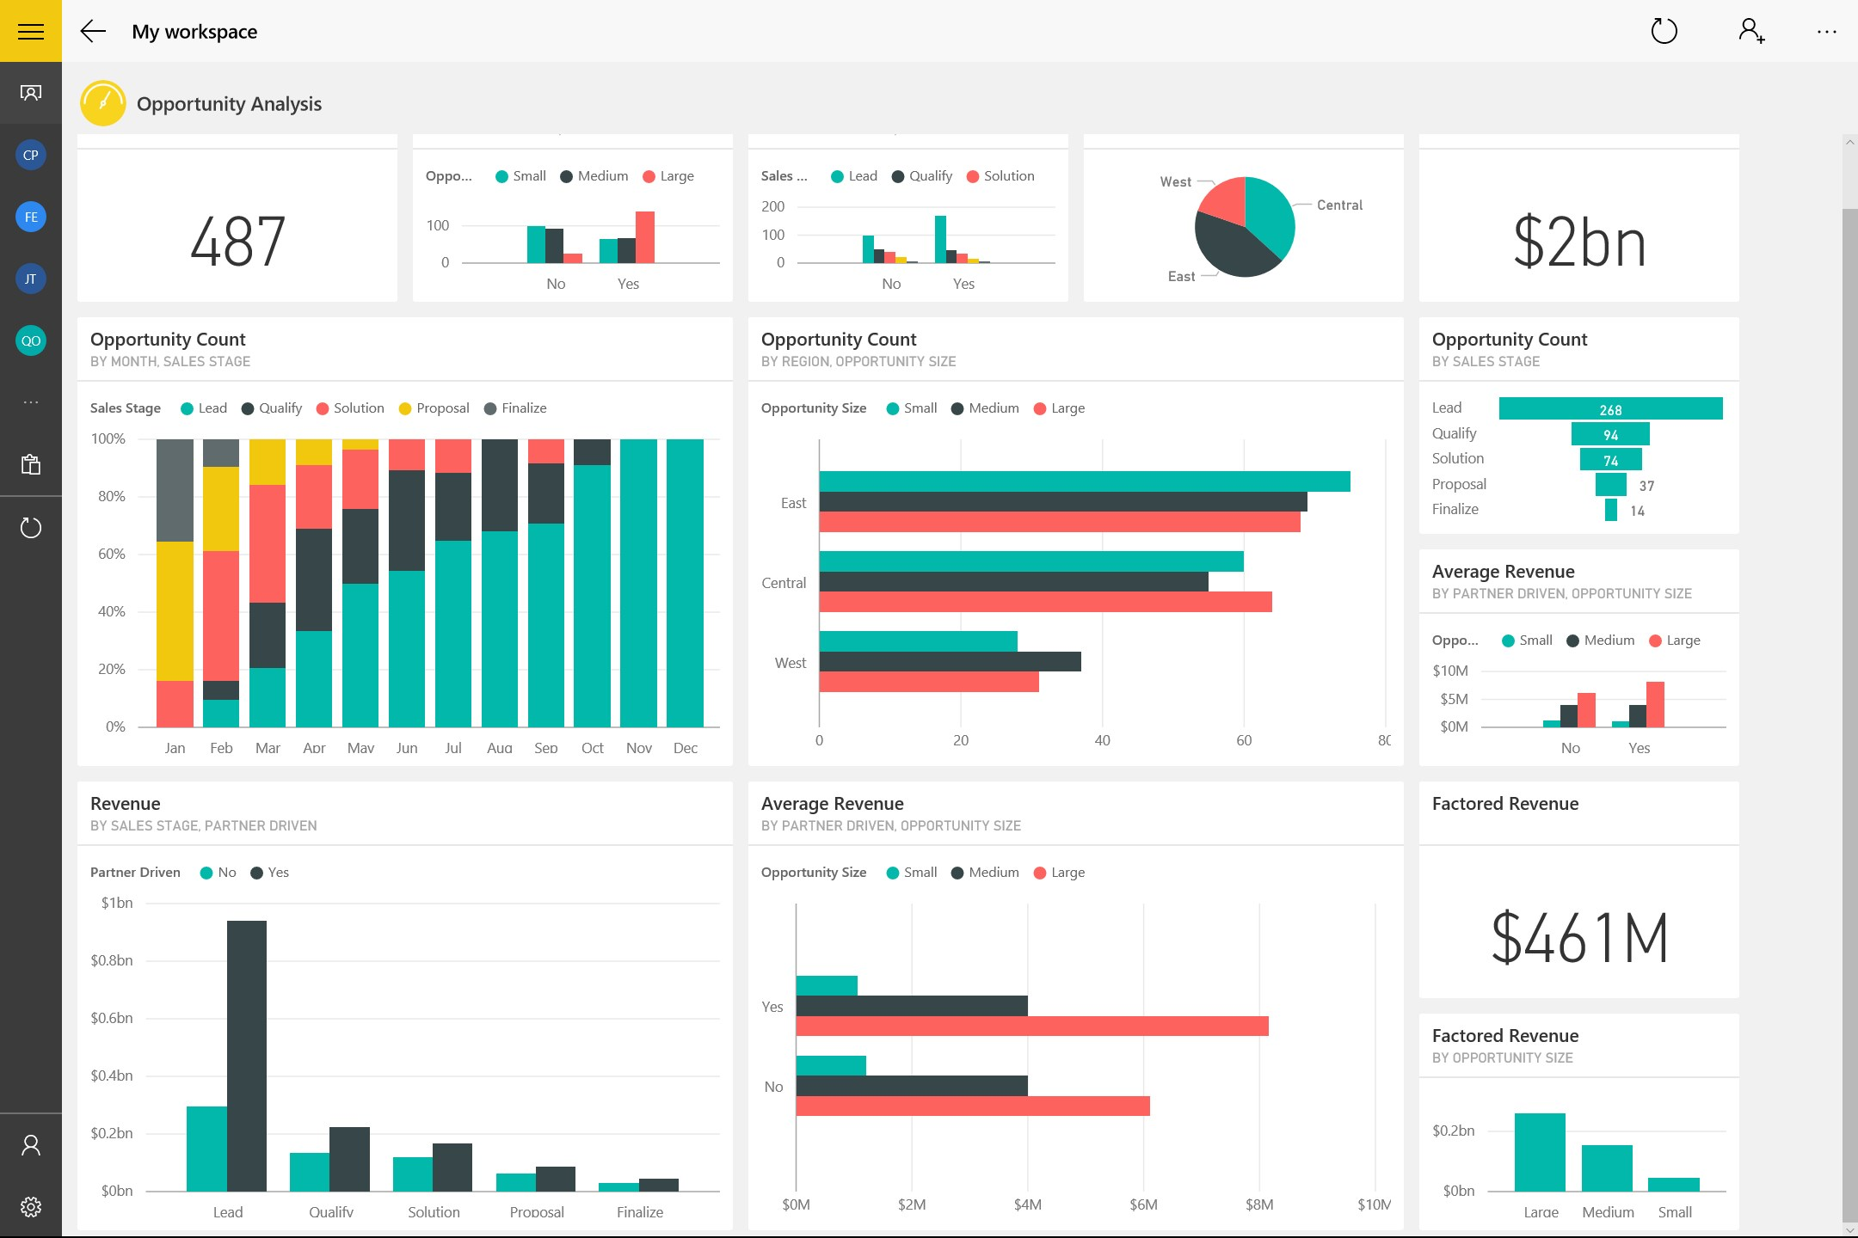

of 20

Slide 8
of 20

Slide 9
of 20

Slide 10
of 20

Slide 11
of 20

Slide 12
of 20

Slide 13
of 20

Slide 14
of 20

Slide 15
of 20

Slide 16
of 20

Slide 17
of 20

Slide 18
of 20

Slide 19
of 20

Slide 20
of 20

